Slide 1

Autonomous Navigation System for Rover
Akhillesh Varathan CS - CB.AI.U4AIM24103 Jeffrin Merino J - CB.AI.U4AIM24118 Deepak Skandh K - CB.AI.U4AIM24119 Kavin M - CB.AI.U4AIM24121
1

Slide 2
INTRODUCTION
Autonomy is the ability of a system or robot to operate independently without human input. It involves decision-making, self-navigation, and path planning, enabling tasks like obstacle avoidance and real-time adjustments. Applications include space exploration, self-driving cars, and industrial automation.
2

Slide 3
PROBLEM STATEMENT
Design an autonomous rover that can:
Navigate unknown environments without human intervention.
Detect and avoid obstacles in real-time.
Plan efficient paths dynamically using sensor inputs.
Operate reliably with low-cost embedded hardware.
3

Slide 4
METHODOLOGY
ESP32-CAM captures and sends images to Raspberry Pi.
YOLOv5 detects obstacles and maps them on a grid.
A* algorithm plans the best path to the destination.
Ultrasonic sensor detects dynamic obstacles and triggers re-planning.
DC motors and servo motor control movement and steering.
Battery and buck converter manage power supply.
4

Slide 5

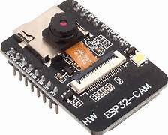
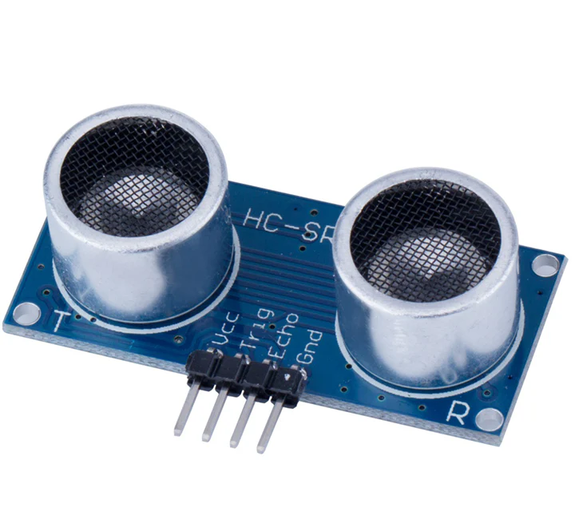
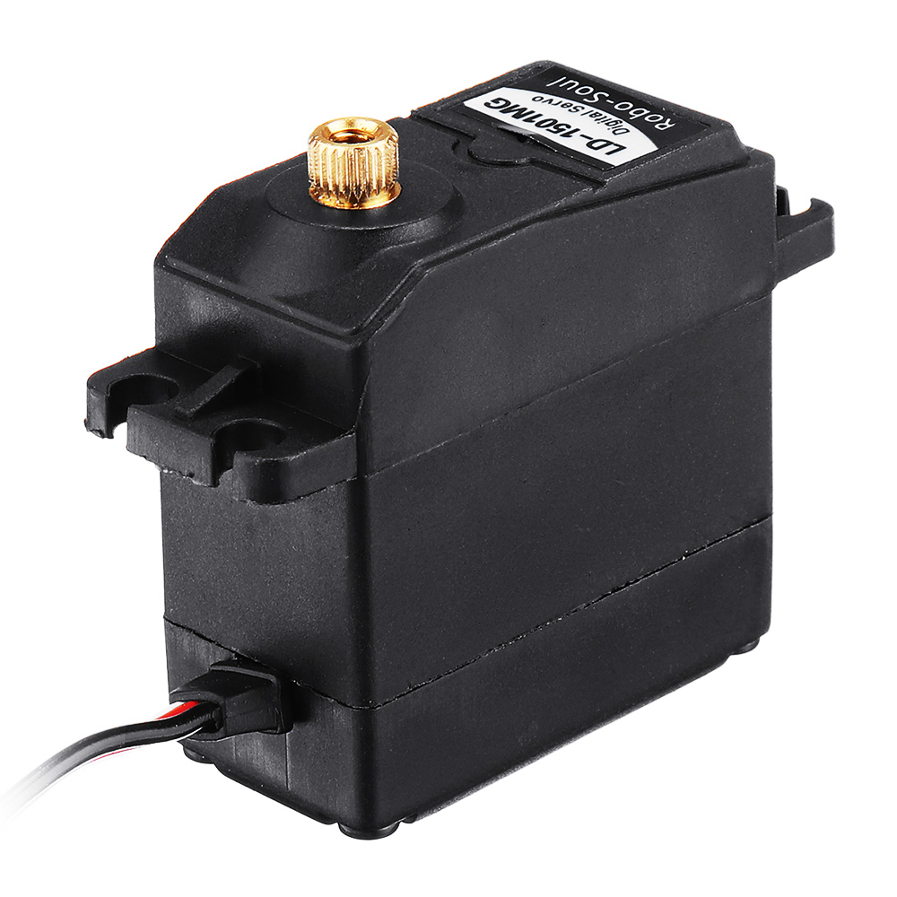
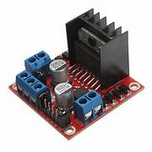
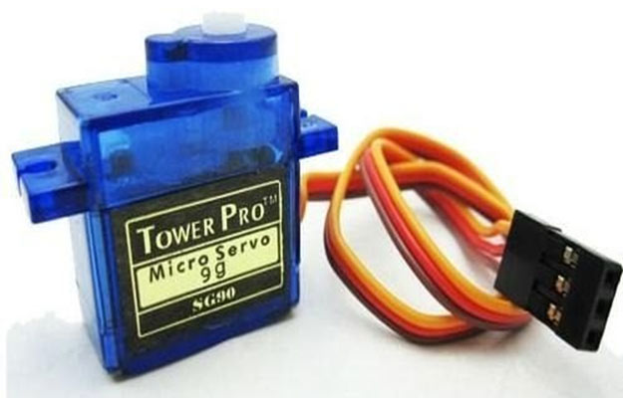
COMPONENTS

Slide 6

YOLOv5s Architecture
INPUT
BACKBONE
Image resized and processed.
CSPDarknet extracts key features
HEAD
NECK
YOLO layer predicts bounding boxes and object classes
PANet combines features at different scales.
YOLOv5s has approximately 214 layers and around 7.2 lakh trainable parameters, making it lightweight and highly efficient for real-time object detection on embedded devices like the Raspberry Pi
6

Slide 7

A* Algorithm
Goal: Find the shortest, obstacle-free path from start to destination.
Grid-Based Map: Environment is divided into free and blocked cells.
Cost Function:
f(x) = g(x) + h(x)
g(x) = cost from start to current node.
h(x) = estimated cost to goal.
Working:
Selects the cell with the lowest f(x) value.
Updates the path dynamically when new obstacles are detected.
Real-Time Update:
New obstacles trigger re-mapping and re-planning.

Slide 8

RESULT Mean Average Precision(mAP@0.5): Total Classes:16
Class | mAP@0.5
Phone | 0.958
Medical tablets | 0.944
Cone Barrel | 0.813
Book | 0.776
Bike | 0.785

Slide 9
COMPONENTS USED
ESP32-CAM - Captures real‑time images and streams them to the Raspberry Pi.(FIG:1)
HC‑SR04 Ultrasonic Sensor - Mounted on a servo; scans for obstacles and updates the map.(FIG:2)
Servo Motor - Rotates the ultrasonic sensor for 180° obstacle scanning.(FIG:5)
L298N Motor Driver - Controls two DC motors’ speed & direction via PWM signals.(FIG:4)
LG1501MG Servo Motor - Controls the steering of the rover by adjusting the angle
of the front wheels based on path planning results.(FIG:3)
9

Slide 10
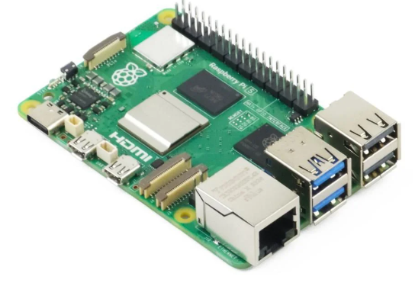
Raspberry Pi
Acts as the main controller of the autonomous rover.
Processes sensor data from the ESP32-CAM .
Runs YOLOv5 for real-time object detection.
Executes A* algorithm for path planning and dynamic re-routing.
Controls motor speed and steering based on sensor inputs
Ensures real-time decision making and autonomous navigation.

Slide 11

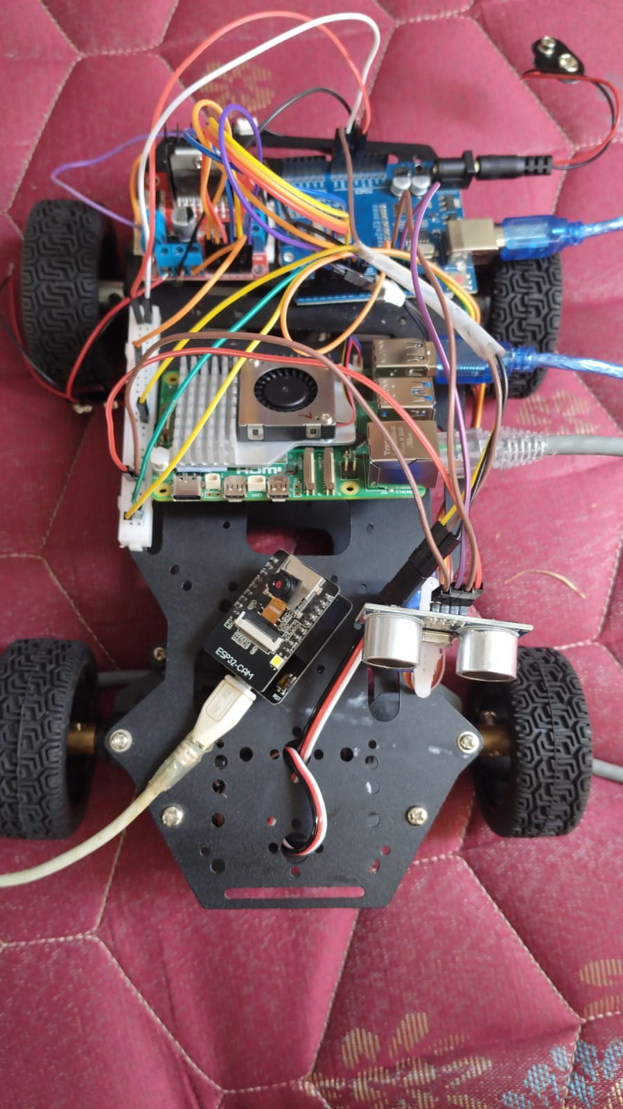
HARDWARE
L298N Motor Driver
Arduino UNO
Raspberry Pi
Servo motor
ESP32-CAM
HC‑SR04 Ultrasonic Sensor
LG1501MG Servo Motor
FIG : Hardware setup of the Autonomous Navigation System Rover

Slide 12
THANK YOU

